Slide 1
CHAPTER 14
Replication, Credibility, and Wider Importance

Slide 2
Chapter Outline
Replication
Research transparency and credibility
Generalization/Real world applications
Notes:
This chapter is divided into three main sections: one section focuses on replicability, a second section focuses on transparency and credibility, and the third section focuses on external validity.

Slide 3
Types of Replication
Direct replication
Conceptual replication
Replication-plus-extension
Notes:
In a replication study, a researcher performs a study again. There are three major types of replication: direct replication, conceptual replication, and replication-plus-extension.

Slide 4
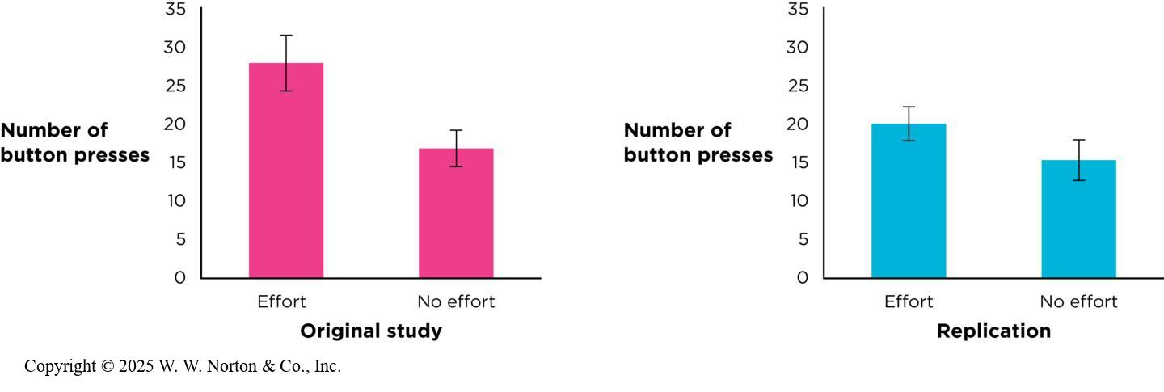
Direct Replication
Notes:
Figure 14.1: Direct Replication of the Baby Persistence Effect
This graph shows the results for the first study (left) and its direct replication study (right) of the baby persistence study. Error bars show the standard error of each mean. (Source: Adapted from open data provided by Leonard et al., 2017.)
Direct replication (aka exact replication): the original study is repeated as closely as possible to determine whether the original effect is found in the new data.
Remember that Leonard et al. (2017), who tested the effect on babies of watching a model persisting longer with a toy, found that babies given the greater persistence treatment persisted longer with the toy they were later given to play with. The study was successfully replicated, and this replication was published alongside the original study in the same article.
Direct replication makes sense, but if there were any threats to internal validity or construct validity in the original study, those threats would be repeated as well. Direct replications also do not test the theory in a new context (Crendall & Sherman, 2016)a
are three major types of replication: direct replication, conceptual replication, and replication-plus-extension.
Copyright © 2025 W. W. Norton & Co., Inc.

Slide 5
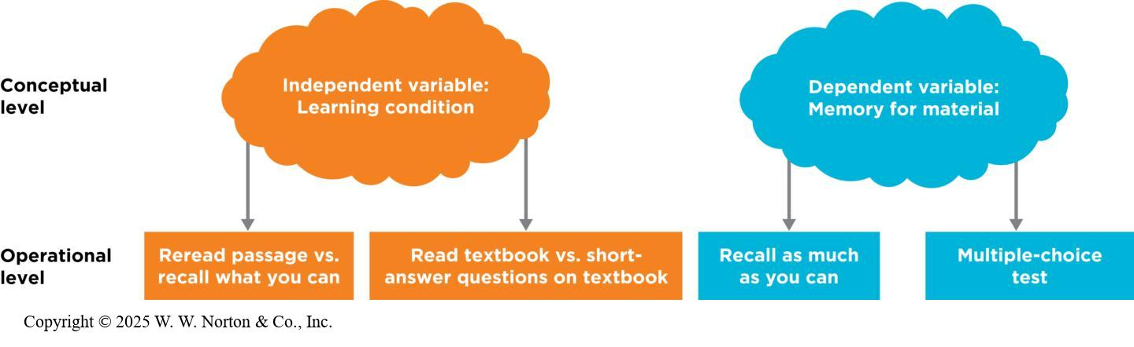
Conceptual Replication
Notes:
Figure 14.2: Conceptual Replication: Manipulating and Measuring the Same Variables with Different Operationalizations
The abstract (conceptual) level of the variables is the same, but the operational level of the variables changes.
Conceptual replication: Researchers explore the same research question but use different procedures. The conceptual variables in the study are the same, but the procedures for operationalizing the variables are different.
Remember the study from Chapter 12 in which Bartholow and Heinz (2006) found that alcohol cues (photos of alcohol) primed people to think about aggression more than neutral cues (photos of plants.)
In a second study, the same researchers conceptually replicated this effect, using the same conceptual variables but using advertisements (for alcohol or other products) instead of photos, and measuring aggressiveness by having people rate a character in a paragraphs behavior as hostile or not hostile. They successfully replicated the effect: when people had just seen alcohol advertisements, they rated the character’s behavior as more hostile, indicating that they were thinking about aggression.
Copyright © 2025 W. W. Norton & Co., Inc.

Slide 6
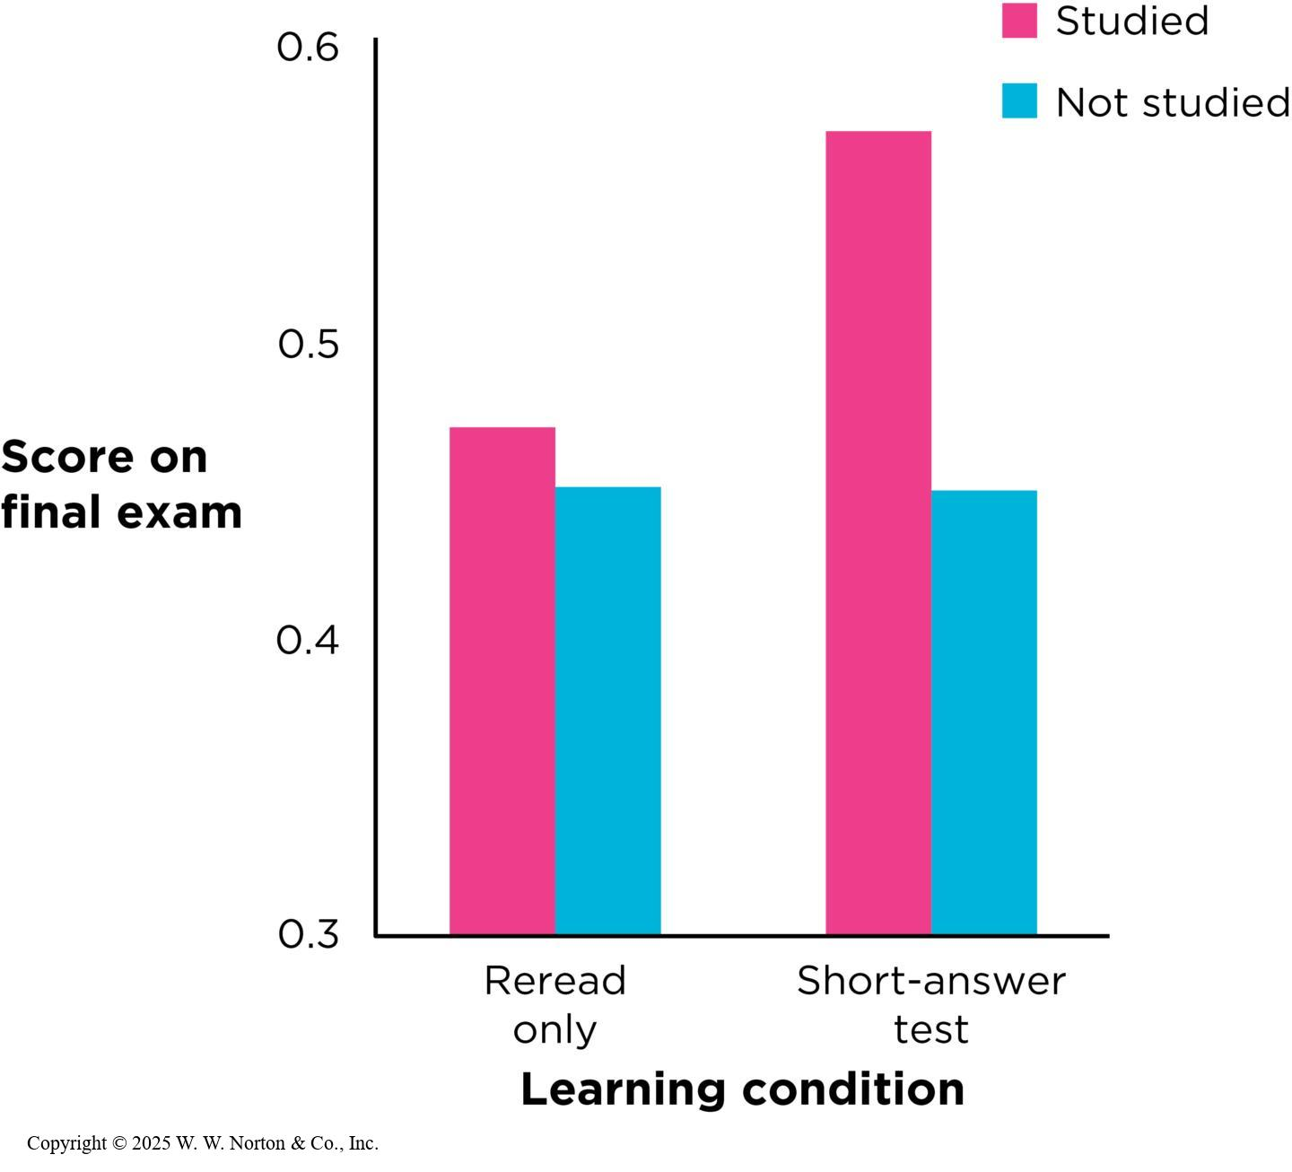
Replication-Plus-Extension
Notes:
Figure 14.3: Results of McDaniel et al.’s (2007) conceptual replication
As in the original study, students who used retrieval practice did better. Error bars were not provided in the original figure and are omitted here. (Source: Adapted from McDaniel et al., 2007.)
Copyright © 2025 W. W. Norton & Co., Inc.

Slide 7
Replication Projects
One study, many labs
Many labs, many studies
Why might a study not be replicable?
Notes:
Recently, things have changed in the field of psychology. Now many prestigious journals encourage replication and reserve pages for publishing direct replication attempts.

Slide 8
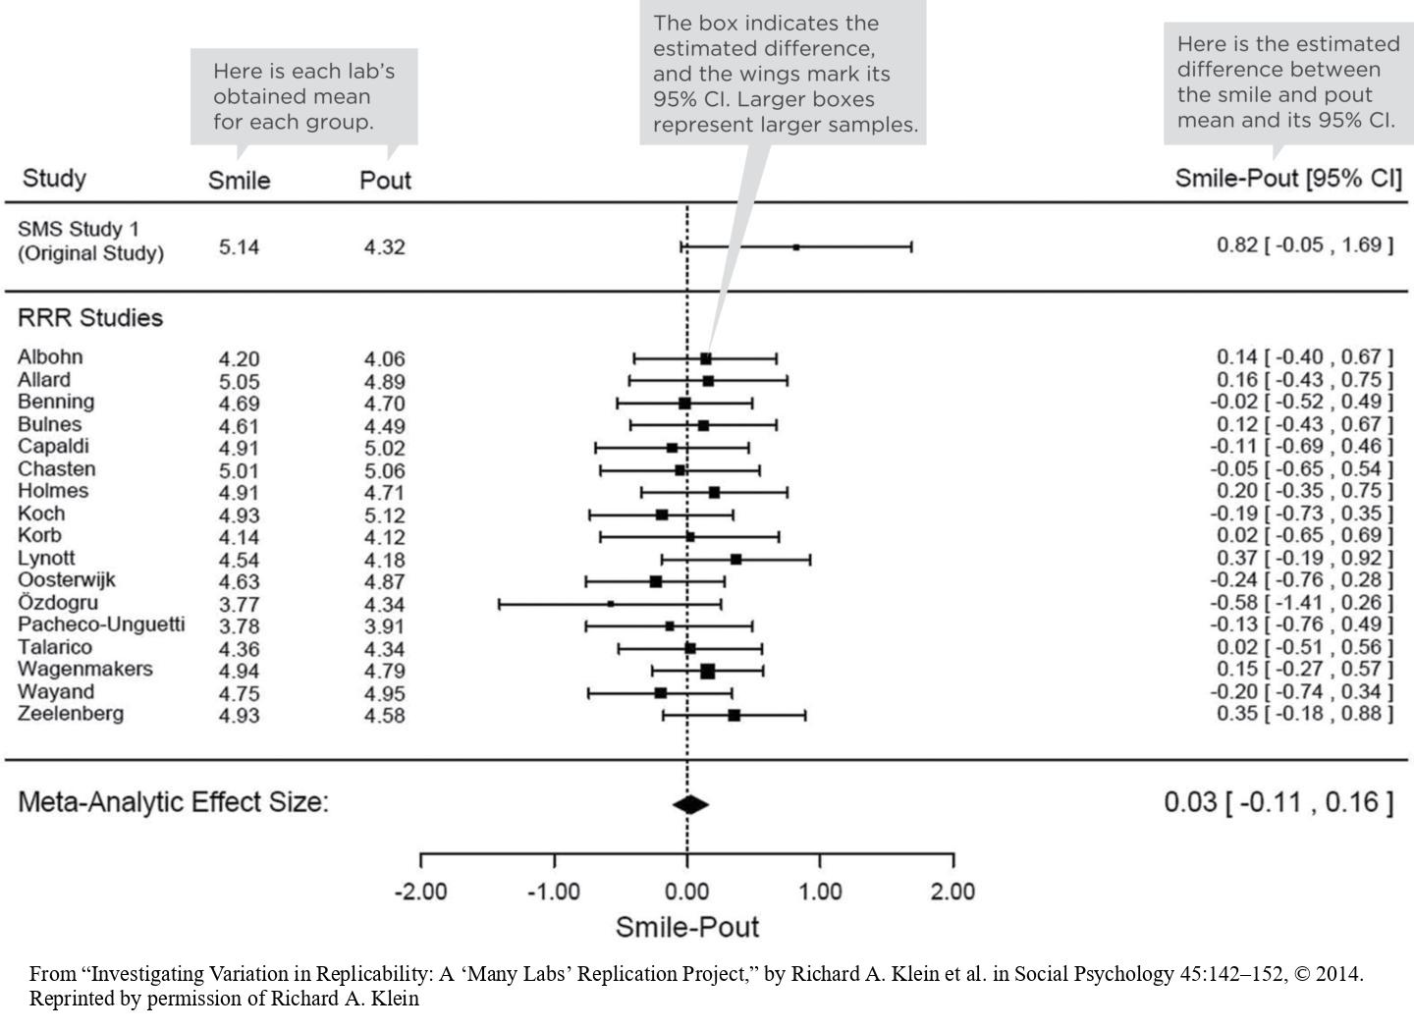
One Study, Many Labs
Notes:
Figure 14.6: One Study, Many Labs
Results of 17 replications of the facial feedback study. All of the 95% CIs included zero, indicating that the original effect was not replicable. SMS = Strack, Martin, and Stepper (the original authors). RRR = Registered Replication Report. You’ll learn about the meta-analytic effect size in the next section.
Sometimes multiple groups of scientists work together to conduct replication studies, and several labs replicate a study at once.
In the example shown on the slide, 17 labs tested the facial feedback hypothesis (Figure 14.5). This hypothesis states that adopting certain facial expressions can influence our emotional experience. The original study (Strack et al., 1998) had people rate a cartoon while holding a pen in either their teeth or lips, forcing a smile or pout. The smile (teeth) group found the cartoons funnier. The 17 labs each collected data from over 50 participants, working with the original authors to ensure as close a replication as possible. The results, as depicted in Figure 14.5, show the funniness ratings estimated by each lab. As you can see, each confidence interval includes zero, leading the project to conclude that “the results were inconsistent with the original result” (Wagenmakers et al., 2016, p. 924).
From “Investigating Variation in Replicability: A ‘Many Labs’ Replication Project,” by Richard A. Klein et al. in Social Psychology 45:142–152, © 2014. Reprinted by permission of Richard A. Klein

Slide 9
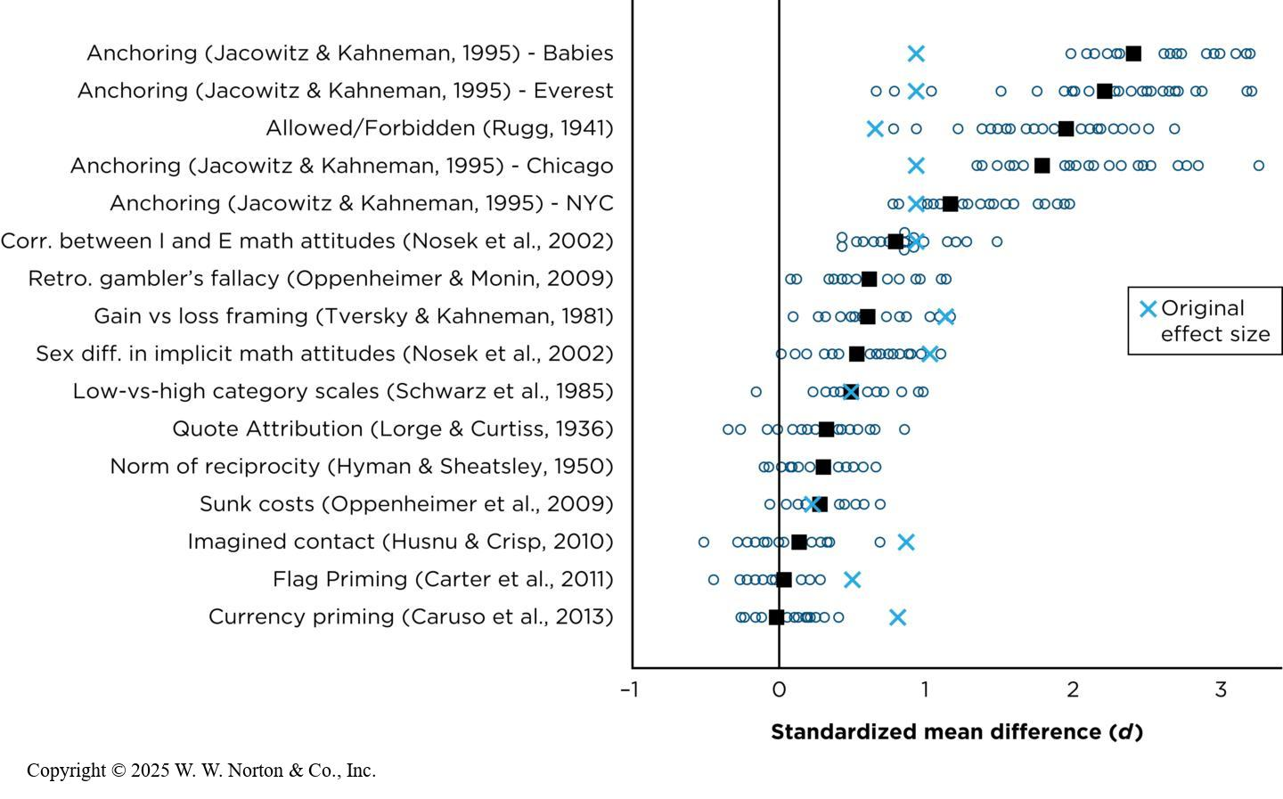
Many Labs, Many Studies
Notes:
Figure 14.7: Many Labs, Many Studies
In this replication project, 36 labs conducted direct replications of 16 studies and their results were combined. Each X represents an original study’s effect size. Each small dot represents the effect estimated by one lab. The black square represents the average effect size combined from all 36 labs. (Source: Adapted from Klein et al., 2014.)
Other replication projects coordinate many labs around the world to replicate a variety of studies. The Open Science Collaboration in 2015 selected 100 studies from three major psych journals and assigned one to each of 100 labs around the world. The project used different studies to judge whether a study was successfully replicated. By one of these metrics, only 39% of the studies cleanly replicated the original effects (Yong, 2015).
Another example (Klein et al., 2014) involved 36 labs around the world each replicating 16 simple studies. One of the effects tested was the anchoring heuristic, in which peoples estimates of a number are influenced by an arbitrary number. For example:
[Fewer] than 50,000 babies are born per day in the United States. How many babies do you think are born in the U.S. each day?
and
More than 100 babies are born per day in the United States. How many babies do you think are born in the U.S. each day?
The original study (Jacowitz & Kahneman, 1995), people who saw the anchor of 50,000tended to give higher estimates than those who saw the anchor of 100, with a d of 0.93, 95% CI [0.51, 1.33]. In Klein et al.’s replication project, all 36 labs replicated this finding, with an average effect size larger than the original (d = 2.6, 95% CI [2.41, 2.76])
The Klein group successfully replicated 14 of the 16 studies, even though the participating labs came from around the world (Figure 14.6).
Replication projects have revealed that while many psychological effects are replicable, some are not. When a study fails to replicate, it could be because of an issue with the replication study, differences in sample, materials, or geography (Van Bavel et al., 2016), or with the original.
Copyright © 2025 W. W. Norton & Co., Inc.

Slide 10
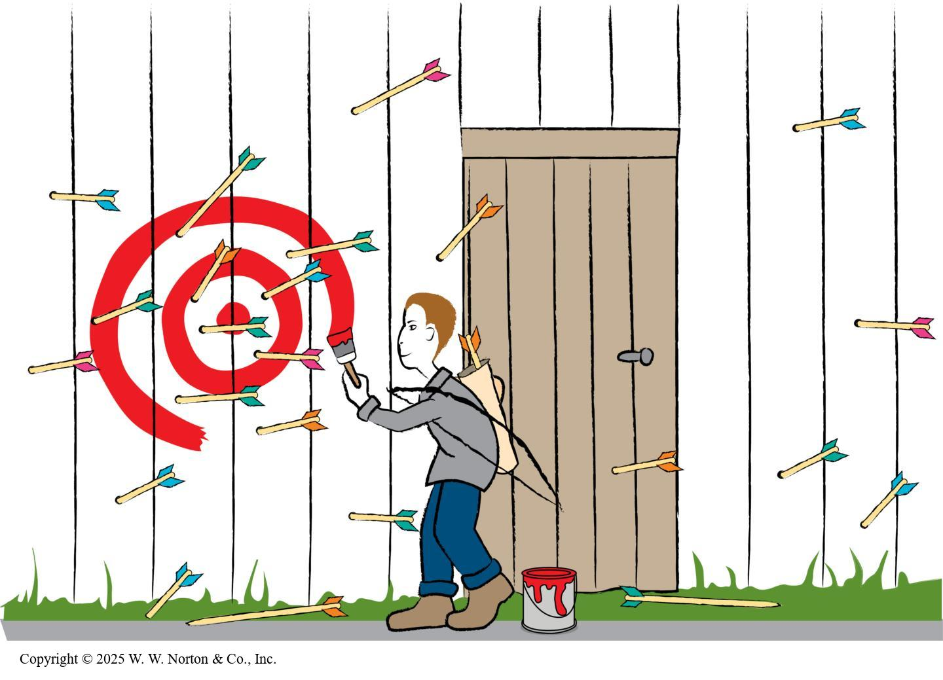
Why Might a Study Not Be Replicable?
Contextually sensitive effects
Number of replication attempts
Notes:
Figure 14.10: Hypothesizing After the Results Are Known (HARKing)
One problematic research practice involves creating a hypothesis after seeing surprising results (Kerr, 1998). Such findings may be due to chance and cannot be replicated. Careful scientists replicate surprising findings in a new, independent study. The practice of preregistration aims to prevent HARKing, because researchers publish their target (the hypothesis) before they start to collect data.
Contextually sensitive effects: Some of the measures and manipulations used in replications may not have had the same meanings as the original. Some original effects are contextually sensitive, and when the replication context is too different, some authors argued, the replication is more likely to fail (Van Bavel et al., 2016; but see Inbar, 2016).
Example: In one original study of how people respond to charitable appeals, the original study mailed actual letters about an AIDS-related charity, but the replication sent emails instead, and they were about an environmental charity. Another original study had Stanford University students watch a video about diversity-related admissions practices; the replication used the same (English) video in the Netherlands, where the university system differs.
Number of replication attempts: The OSC conducted only one replication attempt for each original study, but any single study always has the potential to miss a true finding (leading to a failed replication). To counter this problem, some researchers obtained data from another large-scale effort, the Many Labs Project (MLP), which had conducted up to 36 replications of each study and combined the results of them all. Using this more powerful approach, the replication rate rose to 85% (Gilbert et al., 2016; see, e.g., Klein et al., 2014).
Problems with the original study: In certain cases, the original study’s sample size was too small, so a few extreme individuals could have had a disproportionate influence on means and patterns. In large samples, extreme cases will almost certainly be cancelled out by individuals at other extremes. But in small samples, this is less likely to happen. Small samples can accidentally lead to significant findings that can’t be replicated because there probably wasn’t a real effect in the first place (Fraley & Vazire, 2014; Simonsohn, 2015).
Copyright © 2025 W. W. Norton & Co., Inc.

Slide 11
Meta-Analysis: What Does the Literature Say?
Example: Lying takes time
Strengths and limitations of meta-analysis
Notes:
Scientific literature (aka literature): a series of related studies conducted by different researchers who have tested similar variables.
Meta-analysis: a statistical analysis that yields a quantitative summary of a scientific literature.

Slide 12
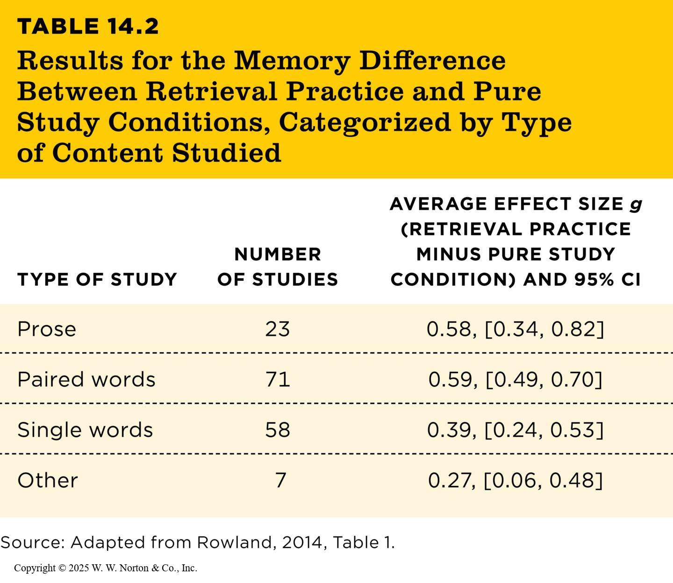
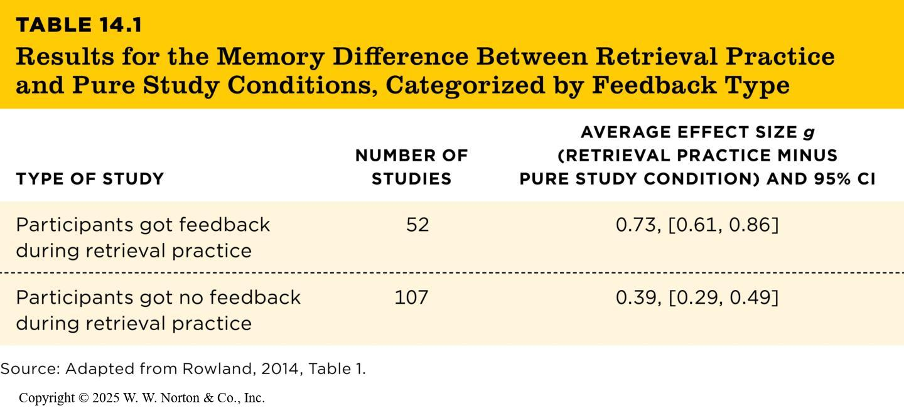
Example: Lying Takes Time
TABLE 14.2
TABLE 14.1
TABLE 14.2 Results for the Memory Difference Between Retrieval Practice and Pure Study Conditions, Categorized by Type of Content Studied
TYPE OF STUDY | NUMBER OF STUDIES | AVERAGE EFFECT SIZE g (RETRIEVAL PRACTICE MINUS PURE STUDY CONDITION) AND 95% CI
Prose | 23 | 0.58, [0.34, 0.82]
Paired words | 71 | 0.59, [0.49, 0.70]
Single words | 58 | 0.39, [0.24, 0.53]
Other | 7 | 0.27, [0.06, 0.48]
Source: Adapted from Rowland, 2014, Table 1.
TABLE 14.1 Results for the Memory Difference Between Retrieval Practice and Pure Study Conditions, Categorized by Feedback Type
TYPE OF STUDY | NUMBER OF STUDIES | AVERAGE EFFECT SIZE g (RETRIEVAL PRACTICE MINUS PURE STUDY CONDITION) AND 95% CI
Participants got feedback during retrieval practice | 52 | 0.73, [0.61, 0.86]
Participants got no feedback during retrieval practice | 107 | 0.39, [0.29, 0.49]
Source: Adapted from Rowland, 2014, Table 1.
Notes:
Table 14.1: Results for the Memory Difference Between Retrieval Practice and Pure Study Conditions, Categorized by Feedback Type
Copyright © 2025 W. W. Norton & Co., Inc.
Table 14.2: Results for the Memory Difference Between Retrieval Practice and Pure Study Conditions, Categorized by Type of Content Studied
Tables 14.1 and 14.2 show the results of a meta-analysis of several studies comparing memory differences between retrieval practice and pure study conditions, as reviewed by Rowland (2014). One type of study involved participants studying a list of words, with one group practicing retrieval (e.g., quizzing themselves) and another group restudying the list without retrieval. Rowland conducted a meta-analysis of 114 studies on this topic, computing the effect size d for each study.
In follow-up analyses, the studies were categorized into different conditions (Table 14.1). For example, some studies emphasized speed during retrieval tasks, while others did not. The theory predicts that retrieval practice benefits would be particularly noticeable under conditions without time pressure. As expected, the average effect size was larger in studies without speed instructions, highlighting that retrieval practice works best without external speed constraints.
The researchers also separately analyzed studies where participants were highly motivated to retain the information, such as studying for an exam (Table 14.2). Motivation moderated the memory differences between retrieval and study conditions, showing that retrieval practice was more effective in scenarios with higher motivation. This suggests that motivation enhances the effectiveness of retrieval practice on long-term memory retention.
Copyright © 2025 W. W. Norton & Co., Inc.

Slide 13
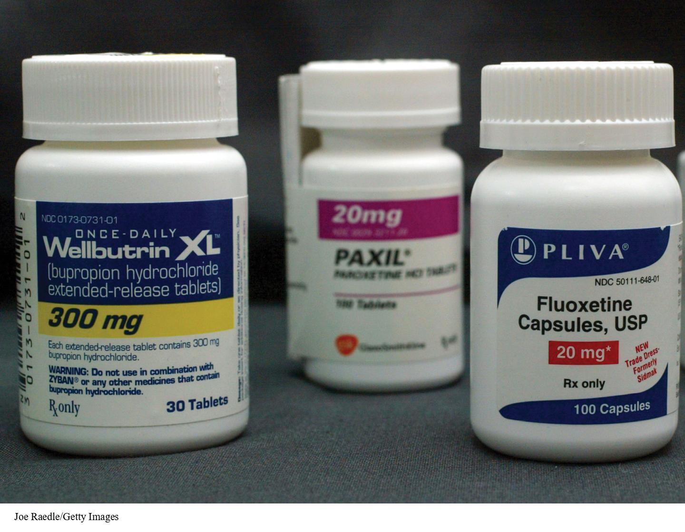
Strengths and Limitations of Meta-Analysis
File drawer problem
Null results and opposite results rarely published
Example: Antidepressants and depressive symptoms
Notes:
Figure 14.9: Selective Publication Rates
About 51% of FDA-registered studies found that antidepressant medications are effective, yet the studies with positive effects are more likely to actually be published in medical journals.
File drawer problem: A meta-analysis might overestimate the true effect size because null effects (or opposite effects) haven’t been included in the analysis; for example: the effectiveness of antidepressant medications on depressive symptoms.
Of 74 studies analyzed, 38 showed positive results, 24 showed negative results, and 12 showed questionable results. All but one of the studies with positive results had been published in medical journals, whereas null findings were less likely to be published. Only three of 36 negative or questionable outcomes were published. If you only examine published studies, then 94% show that antidepressants are effective, but only 51% of registered studies have shown that antidepressants are effective.
Joe Raedle/Getty Images

Slide 14
Replicability and Popular Media
Journalists do not always consider the importance of replicability.
A responsible journalist will not only report on the latest and most exciting studies but also summarize the body of literature on the topic.

Slide 15
Research Transparency and Credibility
Questionable research practices
Transparent research practices

Slide 16
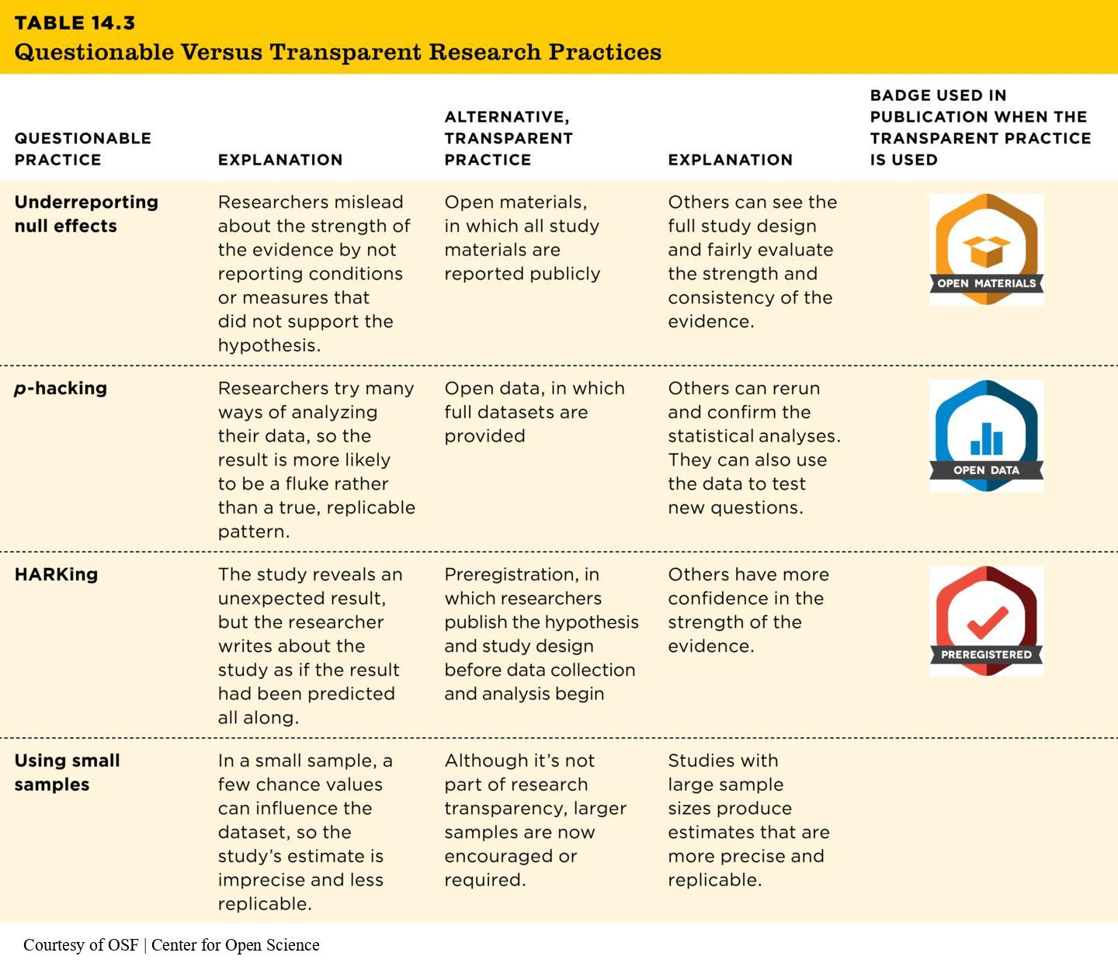
Underreporting and p-Hacking
TABLE 14.3
TABLE 14.3 Questionable Versus Transparent Research Practices
QUESTIONABLE PRACTICE | EXPLANATION | ALTERNATIVE, TRANSPARENT PRACTICE | EXPLANATION | BADGE USED IN PUBLICATION WHEN THE TRANSPARENT PRACTICE IS USED
Underreporting null effects | Researchers mislead about the strength of the evidence by not reporting conditions or measures that did not support the hypothesis. | Open materials, in which all study materials are reported publicly | Others can see the full study design and fairly evaluate the strength and consistency of the evidence.
p-hacking | Researchers try many ways of analyzing their data, so the result is more likely to be a fluke rather than a true, replicable pattern. | Open data, in which full datasets are provided | Others can rerun and confirm the statistical analyses. They can also use the data to test new questions.
HARKing | The study reveals an unexpected result, but the researcher writes about the study as if the result had been predicted all along. | Preregistration, in which researchers publish the hypothesis and study design before data collection and analysis begin | Others have more confidence in the strength of the evidence.
Using small samples | In a small sample, a few chance values can influence the dataset, so the study’s estimate is imprecise and less replicable. | Although it’s not part of research transparency, larger samples are now encouraged or required. | Studies with large sample sizes produce estimates that are more precise and replicable.
Notes:
Table 14.3: Questionable Versus Transparent Research Practices
This table summarizes the examples of questionable practices in the first subsection and matches them with a summary of the alternative, transparent practice.
Courtesy of OSF | Center for Open Science

Slide 17
HARKing and Using Small Samples
TABLE 14.3
TABLE 14.3 Questionable Versus Transparent Research Practices
QUESTIONABLE PRACTICE | EXPLANATION | ALTERNATIVE, TRANSPARENT PRACTICE | EXPLANATION | BADGE USED IN PUBLICATION WHEN THE TRANSPARENT PRACTICE IS USED
Underreporting null effects | Researchers mislead about the strength of the evidence by not reporting conditions or measures that did not support the hypothesis. | Open materials, in which all study materials are reported publicly | Others can see the full study design and fairly evaluate the strength and consistency of the evidence.
p-hacking | Researchers try many ways of analyzing their data, so the result is more likely to be a fluke rather than a true, replicable pattern. | Open data, in which full datasets are provided | Others can rerun and confirm the statistical analyses. They can also use the data to test new questions.
HARKing | The study reveals an unexpected result, but the researcher writes about the study as if the result had been predicted all along. | Preregistration, in which researchers publish the hypothesis and study design before data collection and analysis begin | Others have more confidence in the strength of the evidence.
Using small samples | In a small sample, a few chance values can influence the dataset, so the study’s estimate is imprecise and less replicable. | Although it’s not part of research transparency, larger samples are now encouraged or required. | Studies with large sample sizes produce estimates that are more precise and replicable.
Notes:
Table 14.3: Questionable Versus Transparent Research Practices
This table summarizes the examples of questionable practices in the first subsection and matches them with a summary of the alternative, transparent practice.
Courtesy of OSF | Center for Open Science

Slide 18
Generalization to Real People
External validity and sampling: Reminders
Whom do psychologists study?
Who is doing the research?

Slide 19
External Validity and Sampling: Reminders
It’s a population, not the population.
External validity comes from how, not how many.
Just because a sample comes from a given population doesn’t mean that it generalizes to that population.
Notes:
In order to evaluate a study’s ability to generalize to other people, you need to find out how participants were obtained. A probability sample is intended to generalize to the population from which the sample is drawn, but a convenience sample may not generalize to the population.
It’s a population, not the population: When we refer to a population used in research, we are not talking about everyone in the world or everyone in the United States. That would be “the” population. We are referring to “a” population of interest: the population to which we would like our results to generalize. It might be freshmen at your university or fifth-grade teachers in El Paso, Texas.
External validity comes from how, not how many: How a sample is obtained (random sampling versus biased sampling) is more important than how many participants are in your sample.
Just because a sample comes from a population doesn’t mean it generalizes to that population: It is incorrect to assume that just because a convenience sample includes some members of a population (e.g., perhaps a few dog owners, Asian American men, or Atlanta voters) that it generalizes to all those populations. In order to generalize to a population, you must have a specific probability sample of, in these cases, perhaps a few dog owners, Asian American men, or Atlanta voter.

Slide 20

Whom Do Psychologists Study?
89% of the world's population is underrepresented in psychological research.
Only 15% of U.S. participants in studies are from minoritized populations, though they make up 40% of the U.S. population.
Notes:
Figure 14.11: Generalization to Real People
About 60% of psychology research is conducted on North Americans, which means we don’t know whether it generalizes to other world populations.
Psychological research often relies on convenience samples, predominantly from North America. A significant portion of this research excludes the global population, with only 11% of the world represented. Even within the U.S., minoritized groups are vastly underrepresented, highlighting concerns about generalizability in findings.
AP Photo/Dan Gill

Slide 21
External Validity and the Three Claims
Frequency claims
Association claims
Causal claims
Notes:
External validity is a critical consideration when researchers make frequency claims, which involve estimating how common a variable is in a population. For example, the CDC's 2023 study on depression in teenage girls reported that 57% of U.S. girls showed risk factors for depression. This study used cluster sampling, a probability sampling technique, ensuring that the estimate could generalize to all U.S. teen girls. Without this type of sampling, such claims would lack external validity and thus could not be trusted as representative.
However, association and causal claims focus more on the relationship between variables or cause-effect mechanisms. These types of claims don’t always require external validity in the early stages of research. Instead, researchers prioritize internal validity to ensure that observed effects are truly due to the variables being tested, not external factors. For example, a lab-based study might use convenience samples to test an initial theory before generalizing findings.

Slide 22
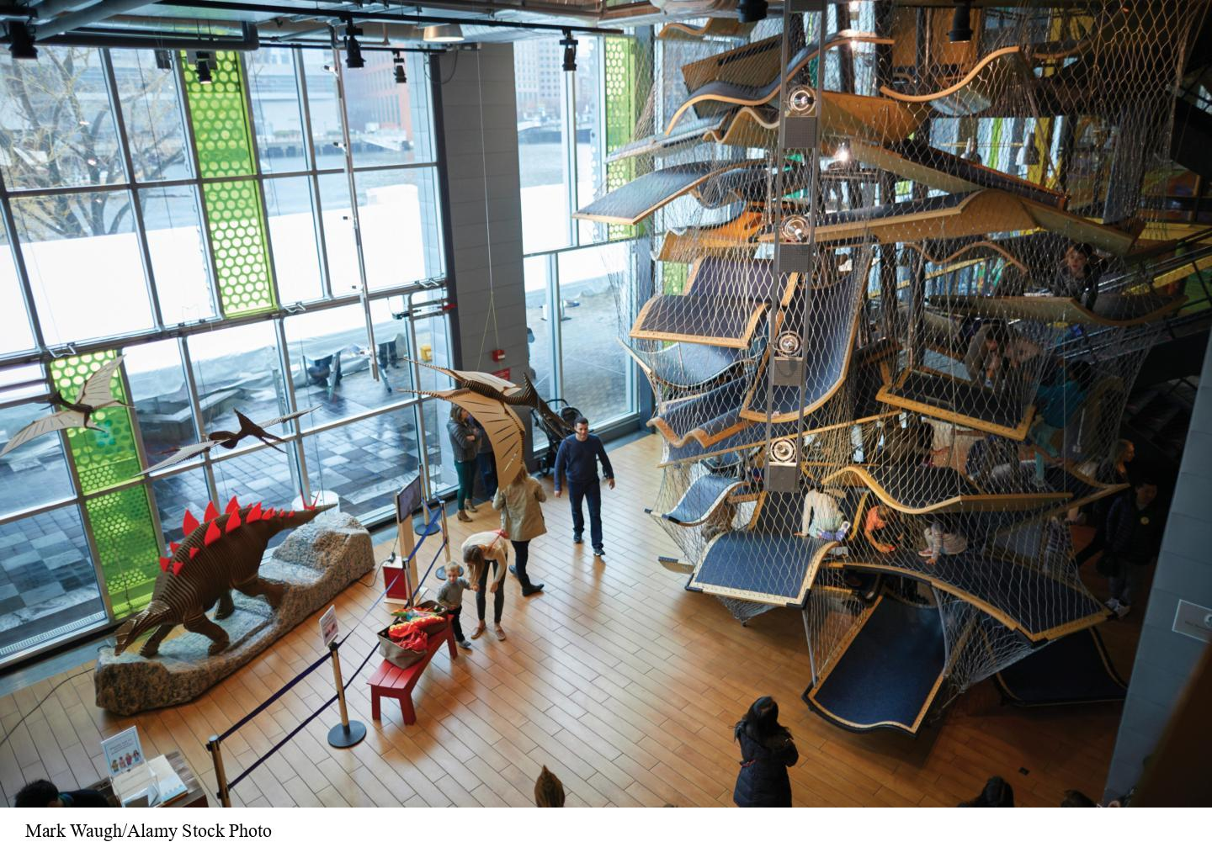
Theory-Testing Mode and Internal Validity
Researchers prioritize internal validity in theory-testing mode.
Example: Harlow’s study on attachment used artificial conditions to test theories
Convenience samples can be justified by universality assumptions.
Notes:
Figure 14.12: How Much Does a Unique Sample Matter?
The study by Leonard et al. (2017) was conducted only on visitors to Boston Children’s Museum, a unique sample. Yet because children were randomly assigned to two conditions, their uniqueness is not a threat to internal validity. Before critiquing the study’s external validity, we would need to specify why the intervention might only work in this sample and not others.
In theory-testing mode, researchers focus on testing the validity of a theory rather than generalizing results to a population. Internal validity becomes the top priority.
For example, Harlow’s classic study on attachment in monkeys aimed to distinguish between two competing theories: the cupboard theory (attachment due to food) and the contact comfort theory (attachment due to physical comfort). Harlow created artificial conditions by designing a cloth mother that provided comfort but no food and a wire mother that provided food but no comfort. His results supported the contact comfort theory. Importantly, Harlow’s sample of monkeys wasn’t representative of wild monkeys, but this didn’t matter because his goal was to test theoretical predictions, not to generalize findings.
Similarly, Leonard’s study on effort models in children relied on a convenience sample of museum-going children from Boston. While this sample may not represent all children, the researchers made a universality assumption: if the effort model influenced this group of children, it would likely influence children from other backgrounds as well. Random assignment further ensured that any baseline differences in the sample did not affect the study’s internal validity.
Mark Waugh/Alamy Stock Photo

Slide 23
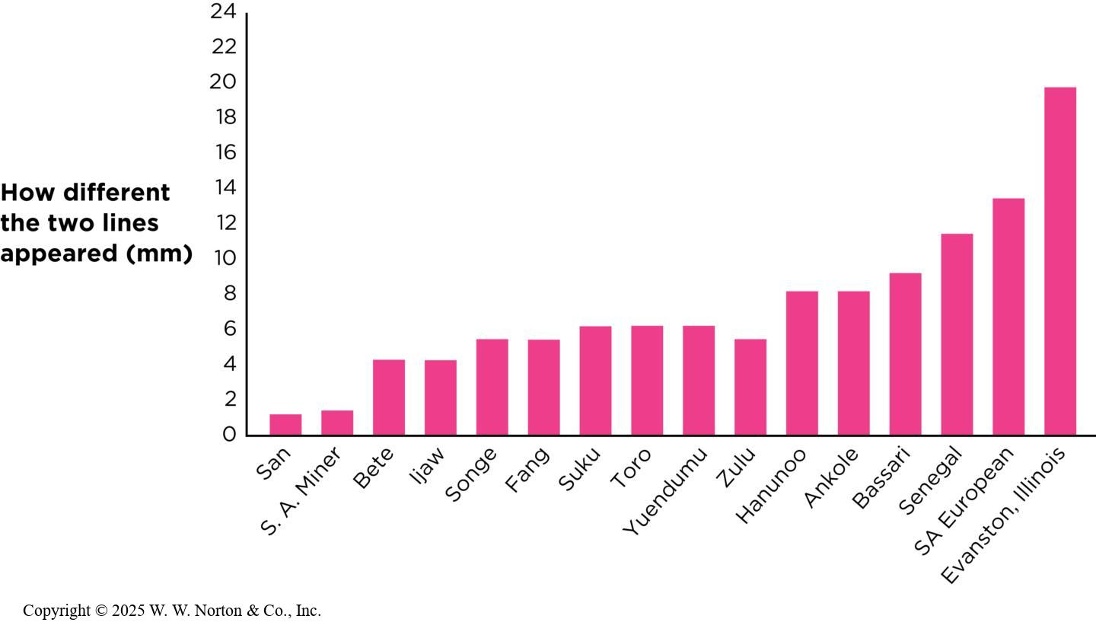
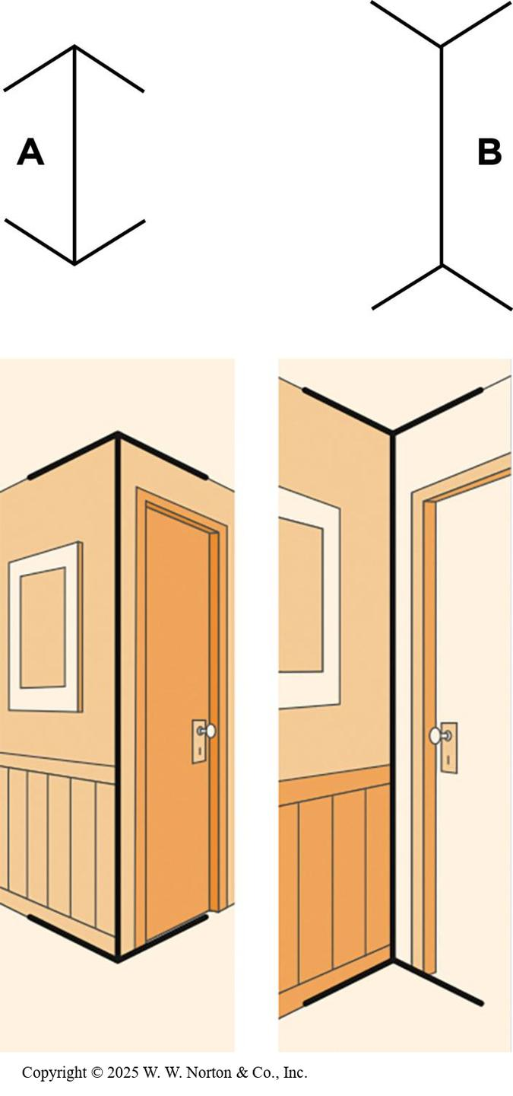
Cultural Psychology: A Special Case of Generalization Mode
The Müller-Lyer illusion
Notes:
Figure 14.13: The Müller-Lyer Illusion
(Top) The vertical lines labeled A and B are the same length, but North Americans and Europeans usually perceive line B to be longer than line A. That perception is not true for all people worldwide. (Bottom) Researchers propose that only people who grow up in “carpentered worlds” learn how combinations of lines generate depth cues. (Source: Heine, 2020.)
Copyright © 2025 W. W. Norton & Co., Inc.
Figure 14.14: Cross-Cultural Results for the Müller-Lyer Illusion
Segall et al. (1966) tested the Müller-Lyer illusion on adults in 16 societies and found that North Americans are most likely to perceive the illusion. The y-axis shows how much longer line B (in Figure 14.11) appears to participants compared with line A. The higher the value, the greater the degree of the illusion. (Source: Adapted from Henrich et al., 2010.)
Cultural psychology: a subdiscipline in psychology focusing on how cultural contexts shape human thinking, feeling, and behavior. Most cultural psychologists tend to emphasize the generalization mode, and they have challenged researchers who operate exclusively in theory-testing mode.
The Müller-Lyer illusion: You might be familiar with this perceptual illusion called the Müller-Lyer Illusion. Does the vertical line B appear longer than the vertical line A? The lines are the same length, but North Americans and Europeans tend to say that line B is longer than line A. If you look at the cross-cultural results on the right, you’ll see that many people around the world do not see line B as being longer than line A.
If researchers from North America were working in a theory-testing mode, then they would probably use a North American sample since generalizability is not a priority. But Segall et al. (1966) were operating in generalization mode in their cross-cultural study with participants from around the world. They were working in generalization mode, and they found that people who grow up in a “carpentered world” have more experiences with right angles as cues for depth perception than those in other societies.
Copyright © 2025 W. W. Norton & Co., Inc.

Slide 24
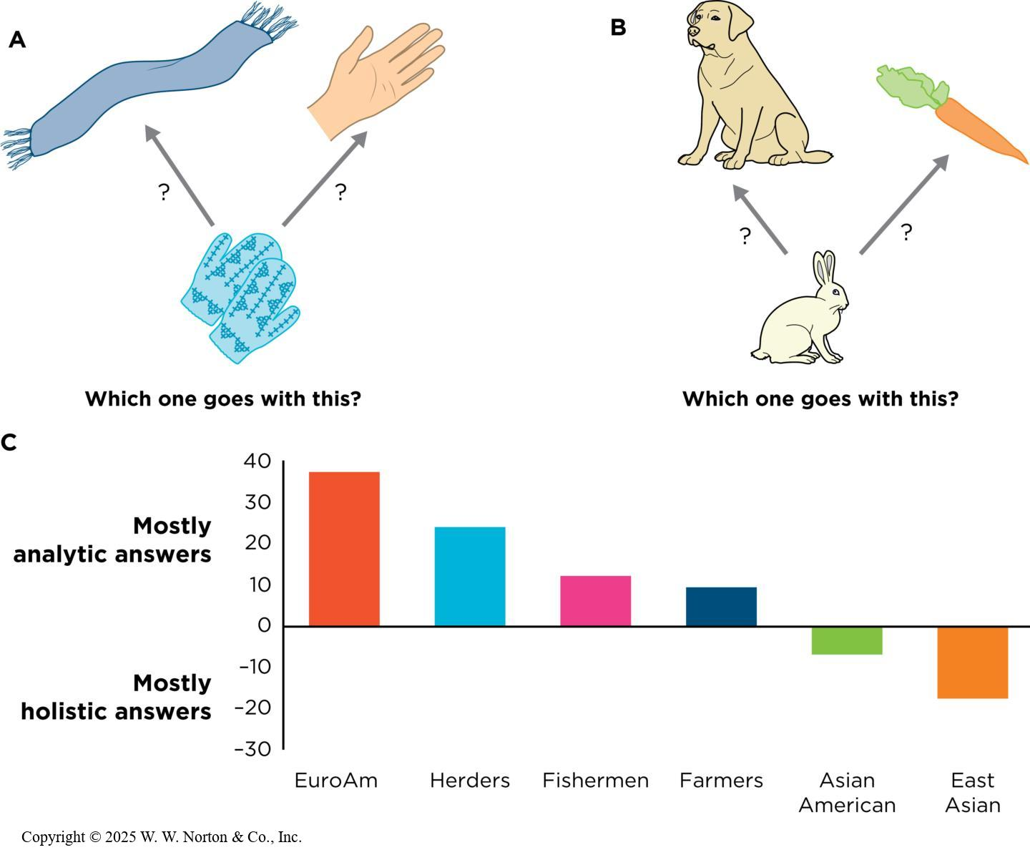
Categorization
Basic psychological processes vary across cultural contexts.
North American students often use analytic thinking.
People from non-WEIRD cultures often use holistic thinking.
Notes:
Figure 14.15: Rules or Functions?
(A and B) An analytic, or rule-based, thinker would combine objects in the same category, such as the mittens with the scarf (clothing) or the rabbit with the dog (animals). A holistic, or functional, thinker would combine objects that have a relationship, such as the mittens with the hand or the rabbit with the carrot. (C) Research shows that people from individualistic, WEIRD cultural contexts make more rule-based combinations. Error bars are omitted because they were not provided in the original figure. (Source: Henrich et al., 2010.)
Categorization patterns differ significantly between WEIRD (Western, Educated, Industrialized, Rich, Democratic) cultures and non-WEIRD cultural contexts. North American students typically categorize items based on analytic thinking, such as grouping items into simple categories like "animals" or "clothing." In contrast, people from non-WEIRD cultures, such as China, Tanzania, or small-scale farming communities, often rely on holistic thinking. This involves recognizing functional or relational connections, such as "hands go inside mittens" or "rabbits eat carrots." These patterns highlight cultural differences in cognitive approaches to seemingly universal tasks like categorization.
Cultural psychologists emphasize that even fundamental psychological processes, such as categorization, are shaped by cultural contexts. For instance, while analytic thinking is prevalent in WEIRD cultures, holistic thinking dominates in non-WEIRD settings. Researchers like Henrich and Arnett argue against the universality assumption often held by studies relying solely on WEIRD participants. Testing psychological theories in diverse populations uncovers the cultural dimensions of cognition, challenging the idea that findings from WEIRD participants can automatically generalize to all humans.
Copyright © 2025 W. W. Norton & Co., Inc.

Slide 25
Generalization To Real Worlds
Lab studies: Prioritize precision and internal validity
Field research (or field experiment): Prioritize real-world relevance and ecological validity
Notes:
Lab-based research focuses on internal validity by controlling variables in a standardized environment. For example, in memory studies, researchers may use word lists with identical word lengths to avoid confounding factors like length affecting recall. Similarly, Harlow’s attachment research used artificial mothers to separate warmth and food.
In contrast, field research happens in real-world settings, offering insights into everyday behaviours and situations. This approach
values ecological validity—the extent to which the tasks and manipulations in a study resemble participants' real-life experiences. While lab studies provide precision, field research offers relevance to practical, real-world questions.
Both laboratory and field research have unique strengths and contribute to a fuller understanding of psychological phenomena. Lab studies are ideal for isolating variables and ensuring internal validity. In contrast, field research provides real-world relevance by studying behaviours and interactions as they occur naturally. Combining findings from both types of studies enhances external validity, helping researchers generalize their results to broader settings and contexts.

Slide 26
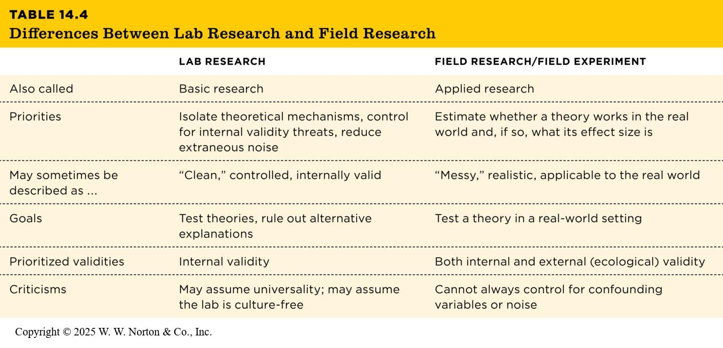
Complementary Goals of Lab and Field Research
TABLE 14.4
TABLE 14.4 Differences Between Lab Research and Field Research
 | LAB RESEARCH | FIELD RESEARCH/FIELD EXPERIMENT
Also called | Basic research | Applied research
Priorities | Isolate theoretical mechanisms, control for internal validity threats, reduce extraneous noise | Estimate whether a theory works in the real world and, if so, what its effect size is
May sometimes be described as ... | “Clean,” controlled, internally valid | “Messy,” realistic, applicable to the real world
Goals | Test theories, rule out alternative explanations | Test a theory in a real-world setting
Prioritized validities | Internal validity | Both internal and external (ecological) validity
Criticisms | May assume universality; may assume the lab is culture-free | Cannot always control for confounding variables or noise
Notes:
Table 14.4: Differences Between Lab Research and Field Research
Lab and field research complement each other by addressing different aspects of the same phenomena. Lab research isolates how, when, and why a phenomenon occurs under controlled conditions. These findings inspire field research to test whether the same mechanisms hold in everyday, real-world settings. Field research, in turn, informs lab studies by presenting new challenges or validating results in real-life contexts. This relationship creates a feedback loop that strengthens our understanding of psychological phenomena and their applications.
Copyright © 2025 W. W. Norton & Co., Inc.

Slide 27
Serial Position Effect
Lab research:
  Murdock (1962): People recall the first and last items in a list better than middle ones (serial position effect)
Field research:
  Roediger & Crowder (1976): Serial position effect observed in recalling U.S. presidents
  Highlights beginning and end items stand out, even in long-term memory
Notes:
The serial position effect illustrates how lab and field research align. In Murdock’s lab study, participants remembered the first and last items of a list, forgetting the middle ones, due to rehearsal and working memory. This effect was later tested in the real world when college students were asked to recall U.S. presidents.
The same pattern emerged—people remembered early presidents like Washington and Adams and recent ones like Obama and Trump but forgot those in the middle. Interestingly, the recency effect here wasn’t due to working memory but because items at the ends of a list naturally stand out, even in long-term memory.

Slide 28
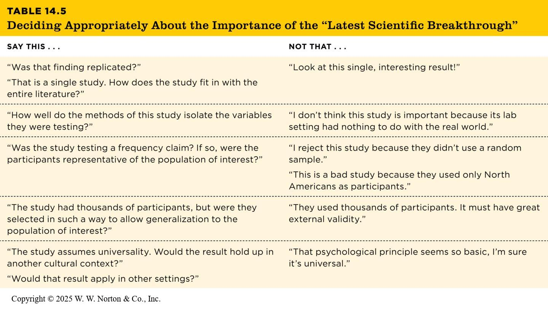
Which Is Better?
TABLE 14.5
TABLE 14.5 Deciding Appropriately About the Importance of the “Latest Scientific Breakthrough”
SAY THIS . . . | NOT THAT . . .
“Was that finding replicated?” “That is a single study. How does the study fit in with the entire literature?” | “Look at this single, interesting result!”
“How well do the methods of this study isolate the variables they were testing?” | “I don’t think this study is important because its lab setting had nothing to do with the real world.”
“Was the study testing a frequency claim? If so, were the participants representative of the population of interest?” | “I reject this study because they didn’t use a random sample.” “This is a bad study because they used only North Americans as participants.”
“The study had thousands of participants, but were they selected in such a way to allow generalization to the population of interest?” | “They used thousands of participants. It must have great external validity.”
“The study assumes universality. Would the result hold up in another cultural context?” “Would that result apply in other settings?” | “That psychological principle seems so basic, I’m sure it’s universal.”
Notes:
Table 14.5: Deciding Appropriately About the Importance of the “Latest Scientific Breakthrough.”
The debate between lab and field research often focuses on their different priorities.
Field setting: This is the real world; it has high external validity (specifically, high ecological validity). However, it may not be generalizable to all possible environments. A healing radio show in Rwanda might not have the same effect with different social problems and a populace that doesn’t have a tradition of radio drama.
Experimental realism: Sometimes studies conducted in laboratories can feel very real. Their tasks might be similar to tasks we do in the real world, and might make people experience authentic emotions, motivations, and behaviors.
Lab and field research are not in competition but are complementary. While lab research excels at testing theories in controlled environments, field research ensures those theories are applicable to real-world situations. For psychology to remain robust and relevant, both approaches are essential. By combining the precision of lab research with the practicality of field studies, researchers can generate findings that are both scientifically rigorous and socially impactful.
Copyright © 2025 W. W. Norton & Co., Inc.

